Slide 1
GASB 68 Webinar: Employers’ Road Map to Successful Implementation July 23, 2015
Presented by the Public Employees Retirement Association
Hosted by the League of Minnesota Cities

Slide 2
GASB 68 Webinar: Employers’ Road Map to Successful Implementation Presenters:
Dave DeJonge,
PERA Interim Executive Director
Jim Riebe,
PERA Principal Accounting Officer

Slide 3
Agenda
At the completion of this webinar, participants will:
Know where to find and how to use the GASB 68 information PERA has prepared for employers.
Be able to prepare:
Journal entries to incorporate pension amounts into government-wide financial statements;
Extensive employer pension footnote disclosures; and
Two required supplementary information pension schedules.
Understand the employer’s and employer auditor’s responsibilities for the pension information.

Slide 4
GASB 68 Overview (1 of 2)
Employers report their proportionate share of collective net pension liability, deferred inflows of resources and deferred outflows of resources, and pension expense on their government-wide financial statements
GASB 67/68 pension amounts calculated by PERA’s actuary
Pension expense calculated as change in net pension liability during the year, plus or minus amortization of deferred inflows and outflows
Pension expense no longer based on contributions to the plan
Employer’s proportionate share calculated by PERA based on employer’s contributions at the measurement date as a percentage of plan contributions from all employers

Slide 5
GASB 68 Overview (2 of 2)
Significantly more footnote disclosures
Disclosures required for each plan
PERA will provide suggested footnote templates
Required supplementary information
Ten-year schedule of employer’s proportionate share of the net pension liability (prospectively applied)
Ten-year schedule of employer contributions (option to provide ten years of information at transition or to apply requirement prospectively)

Slide 6
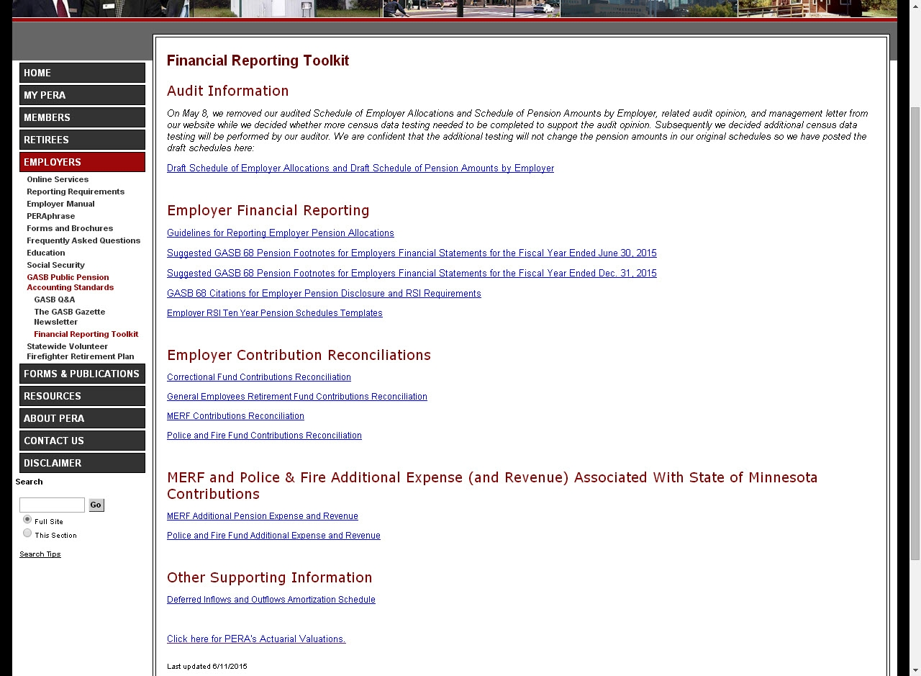

Slide 7
GASB 67/68 Actuarial Information
Gabriel, Roeder, Smith prepares two valuation reports for each plan
GASB 67/68 compliant valuation
Funding valuation
Use GASB 67/68 report to verify collective
pension amounts, NPL +/- 1% sensitivity
analysis
GASB 67/68 valuation includes a NPL reconciliation

Slide 8
Schedule of Employer Allocations
Schedule of Employer Allocations (General Employees Retirement Fund)
As of June 30, 2014
Unit ID | Employer Name | Contributions | Allocation %
0002-00 | AITKIN COUNTY | $598,540 | 0.1573%
0006-00 | ANOKA COUNTY | 6,356,610 | 1.6701
0008-01 | BECKER COUNTY | 814,665 | 0.2140
0010-00 | BELTRAMI COUNTY | 932,224 | 0.2499
0012-00 | BENTON COUNTY REVENUE | 672,279 | 0.1766
0014-00 | BIG STONE COUNTY | 186,634 | 0.0490
0016-00 | BLUE EARTH COUNTY | 1,333,636 | 0.3504
0018-00 | BROWN COUNTY | 683,227 | 0.1795
0020-00 | CARLTON COUNTY | 1,020,241 | 0.2681
0022-00 | CARVER COUNTY | 2,114,127 | 0.5555
0022-09 | CARVER COUNTY HISTORICAL SOCIETY | 9,979 | 0.0026
0024-00 | CASS COUNTY | 849,624 | 0.2232
0026-00 | CHIPPEWA COUNTY | 338,518 | 0.0968
0027-00 | CHIPPEWA COUNTY SWCD | 9,983 | 0.0026
0028-00 | CHIPPEWA COUNTY HOSPITAL | 980,100 | 0.2575
0030-00 | CHISAGO COUNTY | 1,051,266 | 0.2762
… | … | … | …
1855-30 | MINNETONKA ISD-276 | 1,332,949 | 0.3502
… | … | … | …
 |  | $380,612,334 | 100.00000%

Slide 9
PERA Contributions Reconciliation
Public Employees Retirement Association of Minnesota
General Employees Retirement Plan
Reconciliation of Employer Proportionate Share Contributions to Employer Financial Statement Contributions
For the Year Ended June 30, 2014
Revenue Code |  | 4000 | 4005 | YE 2013 | YE 2014 | Subtotal | Subtotal | Total
Employer Unit No. | Employer Name | Employer Contributions - Matching (6.25 or 6.5%) | Employer Contribution - Additional (1%) | Adjustment for Employer Accrual (Received in Current FY but Recognized in Prior FY) | Adjustment for Employer Accrual (Received in Future FY but Recognized in Current FY) | Employer Contributions Allocated for GASB 68 | Employer Contributions NOT Allocated for GASB 68 (Omitted Deductions, Member Buybacks, Employer Portion Paid by Employee, Interest) | Employer Contributions Amount Reported on CAFR
0002-00 | AITKIN COUNTY | $535,331 | $85,649 | $22,440 |  | $598,540 | $0 | $598,540
0006-00 | ANOKA COUNTY | $5,477,764 | $876,443 | $241,438 | $243,840 | $6,356,610 | $358 | $6,356,968
0008-01 | BECKER COUNTY | $702,298 | $112,368 |  |  | $814,665 | $316 | $814,981
0010-00 | BELTRAMI COUNTY | $803,641 | $128,583 |  |  | $932,224 | $0 | $932,224
0012-00 | BENTON COUNTY REVENUE | $579,551 | $92,728 |  |  | $672,279 | $0 | $672,279
0014-00 | BIG STONE COUNTY | $160,891 | $25,742 |  |  | $186,634 | $0 | $186,634
0016-00 | BLUE EARTH COUNTY | $1,149,687 | $183,949 |  |  | $1,333,636 | $0 | $1,333,636
0018-00 | BROWN COUNTY | $588,987 | $94,239 |  |  | $683,227 | $0 | $683,227
0020-00 | CARLTON COUNTY | $911,429 | $146,045 | $37,233 |  | $1,020,241 | $21 | $1,020,262
0022-00 | CARVER COUNTY | $1,822,526 | $291,601 |  |  | $2,114,127 | $471 | $2,114,598
0022-09 | CARVER COUNTY HISTORICAL SOCIETY | $8,602 | $1,376 |  |  | $9,979 | $0 | $9,979
0024-00 | CASS COUNTY | $732,436 | $117,188 |  |  | $849,624 | $0 | $849,624
1855-30 | MINNETONKA ISD-276 | $1,139,847 | $182,365 | $42,096 | $52,843 | $1,332,949 | $4,847 | $1,337,796
… | … | … | … | … | … | … | … | …
Total All Employers |  | $329,397,171 | $52,701,183 | $9,163,798 | $8,522,223 | $381,456,778 | $794,328 | $382,251,106

Slide 10
Schedule of Pension Amounts by Employer (1 of 2)

Slide 11
Schedule of Pension Amounts by Employer (2 of 2)

Slide 12
PERA GASB 68 Reconciliation For Fiscal Year Ended June 30, 2014

Slide 13
Pension Expense
Change in NPL during measurement period +/- deferrals
Source of Change in NPL | Expense/Deferral
Service (Normal) Cost | Immediate
Interest on the TPL | Immediate
Projected Investment Earnings | Immediate
Changes in Benefit Provisions | Immediate
Actuarial Gains and Losses | Expense over average remaining service lives of all active and in-active employees
Changes in Actuarial Assumptions
Changes in Proportionate Share
Differences between Projected and Actual Investment Earnings | Expense over 5-year closed period
Other Changes in the NPL | Immediate

Slide 14
Minnetonka School District GASB 68 Reconciliation For Fiscal Year Ended June 30, 2014
Minnetonka School District
General Employees Retirement Fund
Reconciliation of Beginning Net Pension Liabiliity to Ending Net Pension Liability
(Dollars in Thousands)
 |  |  |  | Plan NPL | District’s Share @ 0.3502 % | Plan Deferred Outflows | Plan Deferred Inflows | District's Share of Plan Deferred Outflows (Amortization Period of 4 Years) | District's Share of Plan Deferred Inflows (Amortization Period of 5 Years) |  | Pension Expense
 |  |  |  |  | 0.003502 |  |  | 4 | 5
Balance at the Beginning of the Year |  |  |  | $5,444,074 | $19,065
Changes for the Year:
 | Service Cost |  |  | $388,391 | $1,360 |  |  |  |  |  | $1,360
 | Interest on Total Pension Liability |  |  | $1,591,756 | $5,574 |  |  |  |  |  | $5,574
 | Interest on Fiduciary Net Position |  |  | $1,174,279 | $4,112 |  |  |  |  |  | $4,112
 | Changes in Benefit Terms |  |  |  | $0 |  |  |  |  |  | $0
 | Liability Experience Gains and Losses |  |  | $96,123 | $337 | $72,092 |  | $252 |  |  | $84
 | Changes in Assumptions |  |  | $645,499 | $2,261 | $484,124 |  | $1,695 |  |  | $565
 | Contributions - Employer |  |  | $382,251 | $1,339 |  |  |  |  |  | $0
 | Contributions - Employees |  |  | $334,495 | $1,171 |  |  |  |  |  | $1,171
 | Asset Gain (Loss) |  |  | $1,586,575 | $5,556 |  | $1,269,260 |  | $4,445 |  | $1,111
 | Benefit Payouts |  |  |  | $0 |  |  |  |  |  | $0
 | Administrative Expenses |  |  | $9,861 | $35 |  |  |  |  |  | $35
 | Other |  |  | $605 | $2 |  |  |  |  |  | $2
Net Changes |  |  |  | $746,575 | $2,615 | $556,216 | $1,269,260 | $1,948 | $4,445 |  | $1,221
Balance End of the Year |  |  |  | $4,697,499 | $16,451 | $556,216 | $1,269,260 | $1,948 | $4,445

Slide 15
Example of Deferred Inflows/Outflows Amortization Schedule
Amortization of Deferred Inflows and Outflows of Resources Related to Pensions
Minnetonka School District
For the Year Ended June 30, 2015
 | General Employees Retirement Fund | Amortization Year 1, 2015 Expensed | Amortization Year 2, 2016 | Amortization Year 3, 2017 | Amortization Year 4, 2018 | Amortization Year 5, 2019 | Total Amortization Years 2 through 5
 | 2014 Remaining Deferred Outflows/Inflows
Differences between expected and actual economic experience | $252,466 |  | $84,155 | $84,155 | $84,155 |  | $252,465
Changes in actuarial assumptions | $1,695,402 |  | $565,134 | $565,134 | $565,134 |  | $1,695,402
Difference between projected and actual investment earnings | -$4,444,949 |  | -$1,111,237 | -$1,111,237 | -$1,111,237 | -$1,111,237 | -$4,444,949
Changes in proportion | $0
Yearly impact on pension expense |  |  | -$461,948 | -$461,948 | -$461,948 | -$1,111,237

Slide 16
Example of Deferred Inflows/Outflows Investment Earnings Amortization Schedule
Minnetonka School District Increase (Decrease) in Pension Expense Arising from the Recognition of Differences
between Projected and Actual Earnings on Pension Plan Investments
Year | Plan | Difference between Projected and Actual Earnings on Investments | Amort-ization Period (Years) | 2015 | 2016 | 2017 | 2018 | 2019 | 2020 | 2021
2015 | PERA | ($5,556,186) | 5 | ($1,111,237) | ($1,111,237) | ($1,111,237) | ($1,111,237) | ($1,111,237) | - | -
2016 | PERA | $6,000,000 | 5 | - | $1,200,000 | $1,200,000 | $1,200,000 | $1,200,000 | $1,200,000
2017
2018
Net Increase (Decrease) in Pension Expense |  |  |  | ($1,111,237) | $88,763

Slide 17
GASB 71
Amends paragraph 137 of GASB 68
Contributions after the measurement date prior to fiscal year end booked to deferred outflows rather than pension expense
At the beginning of the period in which the provisions of Statement 68 are adopted the government should recognize a beginning deferred outflow of resources only for its pension contributions

Slide 18
Transition Year Journal Entries
Minnetonka School District example: employer contributions expensed during initial measurement period are reclassified
Measurement Period
Measurement Date
NPL PERA $19,065,147
District’s Prior Fiscal Year End (and Measurement Date)
District’s Fiscal Year End Reporting Date (and New Measurement Date)
PERA Contributions
$1.337,796
June 30, 2013
June 30, 2014
June 30, 2015

Slide 19
Transition Year Journal Entries
Minnetonka School District:
1) Net position $19,065,147
Net pension liability $19,065,147
Prior period adjustment to recognize beginning net pension liability as of July 1, 2014, for change in accounting principle.
2) Deferred outflows of resources $1,337,796
Net position $1,337,796
Prior period adjustment to reclassify pension contributions during the measurement period (July 1, 2013 through June 30, 2014), which had been closed to net position for the year ended June 30, 2014, as deferred outflows of resources.

Slide 20
Year-End Journal Entries
1 | Net Pension Liability |  | $1,275,864
 | Deferred Outflows |  | $1,947,868
 | Deferred Inflows |  |  | $4,444,949
 | Pension Expense |  | $1,221,217
 | To record FY14 NPL, Deferred Outflows, Deferred Inflows and Pension Expense.
2 | Deferred Outflow |  | -
 | Pension Expense |  | -
 | Net Pension Liability |  |  | -
 | Deferred Inflow |  |  | -
 | To record the change in proportionate share from prior measurement date to current measurement date. This journal entry recognizes the change in proportion between measurement periods and applies the difference to NPL.
3 | Net Pension Liability |  | $1,337,796
 | Deferred Outflow |  |  | $1,337,796
 | To reclassify FY14 contributions

Slide 21
Year-End Journal Entries
4 | Pension Expense |  | -
 | Deferred Outflow |  |  | -
 | To amortize the change in proportionate share from prior valuation to current valuation.
5 | Deferred Outflow of Resources |  | $1,410,595
 | Cash (or Pension Expense) |  |  | $1,410,595
 | To recognize employer contributions made during FY15.

Slide 22
Year-End Journal Entries T-Accounts
 | Minnetonka School District
 | FY 2015 Reporting Period
 | Net Pension Liability |  |  |  | Deferred Outflows |  |  |  | Deferred Inflows |  |  |  | Fringe Benefits Expense
2) | $4,444,949 | $19,065,147 | 1 T) | 2 T) | $1,337,796 | $1,337,796 | 3) |  |  | $4,444,949 | 2) | 1) | $1,410,595 | $1,410,595 | 7)
3) | $1,337,796 | $1,947,868 | 2) | 2) | $1,947,868 | $846 | 5)
5) | $846 | $1,221,217 | 2) | 7) | $1,410,595
 |  | $16,450,641 |  |  | $3,357,617 |  |  |  |  | $4,444,949
 | Pension Expense |  |  |  | Cash (or Pension Expense) |  |  |  | Net Position
2) | $1,221,217 |  |  |  |  | $1,410,595 | 1) | 1 T) | $19,065,147 | $1,337,796 | 2 T)
 | $1,221,217 |  |  |  |  | $1,410,595
 |  |  |  |  |  |  |  |  | $17,727,351
 | Transition year journal entries
 | 1 T) Establish beginning NPL
 | 2 T) Recognize deferred outflows for contributions closed to net position in the prior reporting period (FY 14)
 | Annual journal entries
 | 1) Recognize contributions from the measurement date to the end of the fiscal year (June 30, 2015)
 | 2) Recognize pension expense, deferred inflows and deferred outflows at the measurement date
 | 3) Reclassify contributions made during the measurement period (FY 14)
 | 4) Change in proportionate share ($0 first year)
 | 5) Difference in contributions used as the basis for the proportionate share allocation and contributions reported in the district's financial statements at the measurement date (to be determined by district)
 | 6) Recognize pension expense for this year's amortization of prior year deferred inflows and outflows of resources (n/a for transition year)
 | 7) Reclassify contributions after the measurement date

Slide 23
Suggested GASB 68 Footnotes

Slide 24
RSI Schedule of Employer’s Proportionate Share of the Net Pension Liability
Ten-year schedule presenting, by plan:
Employer’s proportion, both percentage and amount, of the collective NPL
Employer’s covered-employee payroll as of the measurement date
Employer’s amount of the collective NPL as a percentage of employee covered payroll
Plan’s fiduciary net position as a percentage of the total pension liability

Slide 25
Schedule of Proportionate Share of the Net Pension Liability
 |  | Minnetonka School District’s Proportionate Share of the Net Pension Liability
 |  | PERA General Employees Retirement Fund
 |  | Required Supplementary Information (Last Ten Years*)
Fiscal Year Ending | Proportion (Percentage) of the Net Pension Liability (Asset) | Proportionate Share (Amount) of the Net Pension Liability (Asset) (a) | Covered-Employee Payroll (b) | Proportionate Share of the Net Pension Liability (Asset) as a Percentage of its Covered-Employee Payroll (a/b) | Plan Fiduciary Net Position as a Percentage of the Total Pension Liability
June 30, 2014 | 0.3502% | $16,450,641 | $18,384,703 | 89.48% | 78.75%
* Schedule is to be provided prospectively beginning with the employer's fiscal year ended June 30, 2015, or after.

Slide 26
RSI Schedule of Employer Contributions
Ten year schedule, by plan:
Statutorily required employer contributions
Actual contributions paid by employer
Difference between required and paid contributions
Amount of contributions paid in relation to required contributions as a percentage of the employer’s covered-employee payroll as of the reporting date

Slide 27
Schedule of Contributions
 |  | Minnetonka School District Schedule of Contributions
 |  | PERA General Employees Retirement Fund
 |  | Required Supplementary Information (Last Ten Years*)
Fiscal Year Ending | Statutorily Required Contribution (a) | Contributions in Relation to the Statutorily Required Contribution (b) | Contribution Deficiency (Excess) (a-b) | Covered-Employee Payroll (d) |  | Contributions as a Percentage of Covered-Employee Payroll (b/d)
June 30, 2015 | $1,410,595 | $1,410,595 | $0 | $21,653,569** |  | .065%
June 30, 2014
June 30, 2013
June 30, 2012
June 30, 2011
June 30, 2010
June 30, 2009
June 30, 2008
June 30, 2007
June 30, 2006
* Option to provide RSI for ten years at transition or to provide RSI prospectively. **Estimated for purposes of illustration.

Slide 28
Annual Timeline
June 30—Fiscal year end (Measurement Date)
August—Census and asset data sent to actuary
November—Actuarial valuations finalized
December 1—PERA prepares GASB schedules
December—Plan auditor finalizes GASB 68 audit
January 10—PERA publishes GASB schedules and audit report

Slide 29
Summary
Every year PERA will provide audited GASB 68 information on its website (Financial Reporting Toolkit)
Independent Auditor’s Report and Management Letter
Schedule of Employer Allocations
Schedule of Pension Amounts by Employer
Notes to the pension allocation schedules
The information should be available by late July/August in 2015 for employers with a June 30 fiscal year, and in January in future years

Slide 30
Cost-Sharing Plans: Employer Responsibilities
Report
Complete and accurate census data to plan
Appropriateness of information used to record financial statement amounts Whether plan auditor’s report on schedules are adequate and appropriate for employer purposes
Amounts in schedules specific to employer employer amount used in allocation percentage (numerator) recalculate allocation percentage of employer recalculate allocation of pension amounts based on allocation percentage of employer
Evaluate
Verify & Recalculate

Slide 31
Cost-Sharing Plans: Employer Auditor Responsibilities
Determine
Sufficiency and appropriateness of audit evidence
Whether plan auditor’s report on schedules are adequate and appropriate for auditor purposes (e.g., evidence) Review plan auditor’s report and any related modifications Evaluate whether plan auditor has necessary competence and independence Determine whether named as specified user
Amounts in schedules specific to employer Employer amount used in allocation percentage (numerator) Recalculate allocation percentage of employer Recalculate allocation of pension amounts based on allocation percentage of employer
Census data submitted to plan
Evaluate
Verify & Recalculate
Test

Slide 32
More Information
PERA’s website
www.mnpera.org
Employers tab
GASB 68 Public Pension Accounting Standards
Contact Jim Riebe at GASB@mnpera.org

